Slide 1

Chapter 3 – part 1
Domain Name
System: DNS
Objectives
Upon completion you will be able to:
Understand how the DNS is organized
Know the domains in the DNS
Know how a name or address is resolved
Be familiar with the query and response formats
Understand the need for DDNS
TCP/IP Protocol Suite

Slide 2
3.1 NAME SPACE
The names assigned to machines must be unique because the addresses are unique. A name space that maps each address to a unique name can be organized in two ways: flat or hierarchical.
The topics discussed in this section include:
Flat Name Space
Hierarchical Name Space
TCP/IP Protocol Suite

Slide 3
3.2 DOMAIN NAME SPACE
The domain name space is hierarchical in design. The names are defined in an inverted-tree structure with the root at the top. The tree can have 128 levels: level 0 (root) to level 127.
The topics discussed in this section include:
Label
Domain Name
Domain
TCP/IP Protocol Suite

Slide 4
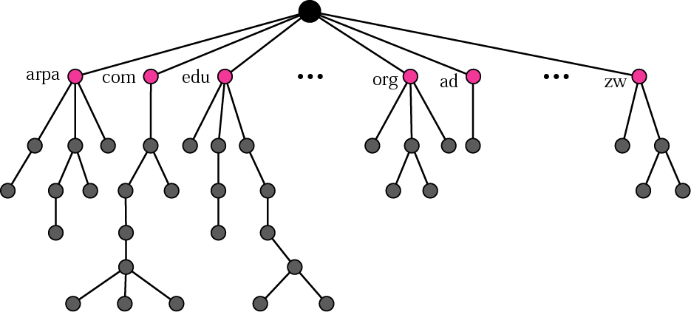
Figure 3.1 Domain name space
TCP/IP Protocol Suite

Slide 5
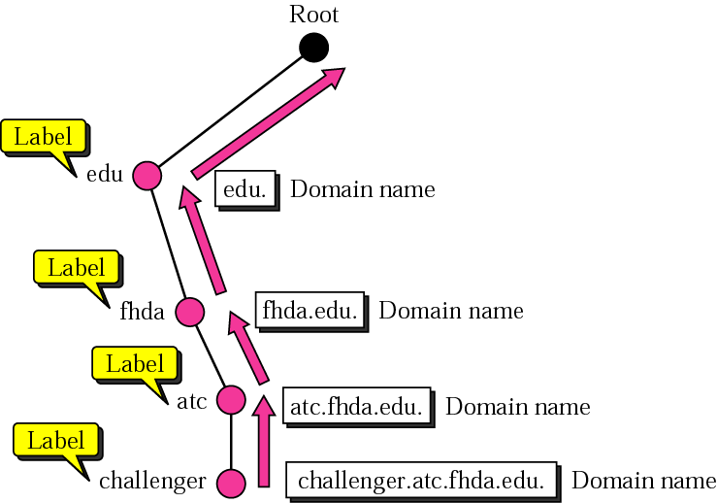
Figure 3.2 Domain names and labels
TCP/IP Protocol Suite

Slide 6
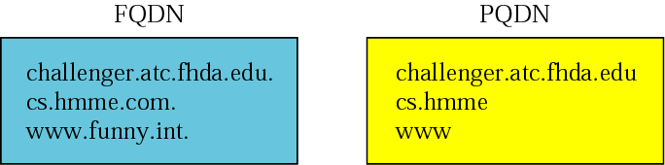
Figure 3.3 FQDN and PQDN
TCP/IP Protocol Suite

Slide 7
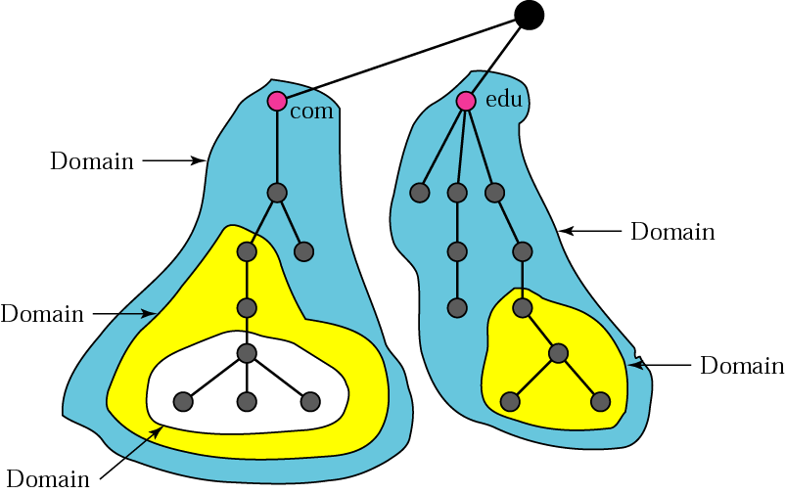
Figure 3.4 Domains
TCP/IP Protocol Suite

Slide 8
3.3 DISTRIBUTION OF
NAME SPACE
The information contained in the domain name space is distributed among many computers called DNS servers.
The topics discussed in this section include:
Hierarchy of Name Servers
Zone
Root Server
Primary and Secondary Servers
TCP/IP Protocol Suite

Slide 9
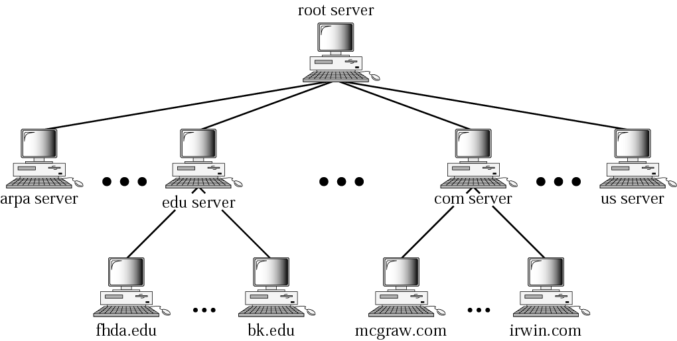
Figure 3.5 Hierarchy of name servers
TCP/IP Protocol Suite

Slide 10
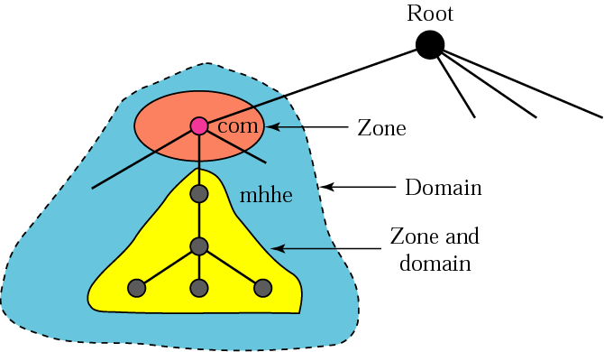
Figure 3.6 Zones and domains
TCP/IP Protocol Suite

Slide 11

DNS Names 3
Domain names can be mapped to a tree.
New branches at the ‘dots’
No restriction to the amount of branches.
ws1
ws2
ftp
•
www
www
disi
•
•
sun
ripe
isi
tislabs
•
moon
•
•
google
net
edu
com
•

Slide 12
Domains
Domains are “namespaces”
Everything below .com is in the com domain.
Everything below ripe.net is in the ripe.net domain and in the net domain.
com domain
•
net
edu
com
•
•
•
google
ripe.net domain
ripe
isi
sun
tislabs
•
moon
•
net domain
www
disi
ftp
•
www
ws2
ws1

Slide 13
Delegation
Administrators can create subdomains to group hosts
  According to geography, organizational affiliation or any other criterion
An administrator of a domain can delegate responsibility for managing a subdomain to someone else
  But this isn’t required
The parent domain retains links to the delegated subdomain
  The parent domain “remembers” who it delegated the subdomain to

Slide 14
Concept: Zones and Delegations
Zones are “administrative spaces”
Zone administrators are responsible for portion of a domain’s name space
Authority is delegated from a parent and to a child
net zone
•
net
edu
com
net domain
•
•
•
google
ripe.net zone
ripe
isi
sun
tislabs
•
moon
•
www
disi
disi.ripe.net zone
ftp
•
www
ws2
ws1

Slide 15
Concept: Name Servers
Name servers answer ‘DNS’ questions.
Several types of name servers
  Authoritative servers
    master (primary)
    slave (secondary)
  (Caching) recursive servers
    also caching forwarders
  Mixture of functionality

Slide 16
Concept: Name Servers authoritative name server
Give authoritative answers for one or more zones.
The master server normally loads the data from a zone file
A slave server normally replicates the data from the master via a zone transfer
slave
master
slave

Slide 17
Concept: Name Servers recursive server
Recursive servers do the actual lookups; they ask questions to the DNS on behalf of the clients.
Answers are obtained from authoritative servers but the answers forwarded to the clients are marked as not authoritative
Answers are stored for future reference in the cache

Slide 18
Concept: Resolvers
Resolvers ask the questions to the DNS system on behalf of the application.
Normally implemented in a system library (e.g, libc)
  gethostbyname(char *name);
  gethostbyaddr(char *addr, int len, type);

Slide 19
Concept: Resolving process & Cache
Question: www.ripe.net A
root-server
www.ripe.net A ?
www.ripe.net A ?
Ask net server @ X.gtld-servers.net (+ glue)
Caching
forwarder
(recursive)
Resolver
193.168.5.10
www.ripe.net A ?
gtld-server
Ask ripe server @ ns.ripe.net (+ glue)
Add to cache
www.ripe.net A ?
193.168.5.10
ripe-server

Slide 20
Concept: Resource Records (more detail)
Resource records consist of it’s name, it’s TTL, it’s class, it’s type and it’s RDATA
TTL is a timing parameter
IN class is widest used
There are multiple types of RR records
Everything behind the type identifier is called rdata
www.ripe.net. 3600 IN A 10.10.10.2
ttl
rdata
Label
type
class

Slide 21
Example: RRs in a zone file
ripe.net. 7200 IN SOA ns.ripe.net. olaf.ripe.net. (
2001061501 ; Serial
43200 ; Refresh 12 hours
14400 ; Retry 4 hours
345600 ; Expire 4 days
7200 ; Negative cache 2 hours
)
ripe.net. 7200 IN NS ns.ripe.net.
ripe.net. 7200 IN NS ns.eu.net.
pinkje.ripe.net. 3600 IN A 193.0.1.162
host25.ripe.net. 2600 IN A 193.0.3.25
Label
ttl
class
type
rdata

Slide 22
Resource Record: SOA and NS
The SOA and NS records are used to provide information about the DNS itself.
The NS indicates where information about a given zone can be found:
The SOA record provides information about the start of authority, i.e. the top of the zone, also called the APEX.
ripe.net. 7200 IN NS ns.ripe.net.
ripe.net. 7200 IN NS ns.eu.net.

Slide 23
Resource Record: SOA
Master server
Contact address
net. 3600 IN SOA A.GTLD-SERVERS.net. nstld.verisign-grs.com. (
2002021301 ; serial
30M ; refresh
15M ; retry
1W ; expiry
1D ) ; neg. answ. ttl
Version number
Timing parameter

Slide 24
Concept: TTL and other Timers
TTL is a timer used in caches
  An indication for how long the data may be reused
  Data that is expected to be ‘stable’ can have high TTLs
SOA timers are used for maintaining consistency between primary and secondary servers

Slide 25
Places where DNS data lives
Changes in DNS do not propagate instantly!
Slave
Might take up to refresh
to get data from master
Not going to net if TTL>0
Cache server
Upload of zone
data is local policy
Master
Registry DB
Slave server

Slide 26

Note:
A primary server loads all information from the disk file; the secondary server loads all information from the primary server. When the secondary downloads information from the primary, it is called zone transfer.
TCP/IP Protocol Suite

Slide 27
3.4 DNS IN THE INTERNET
The domain name space (tree) is divided into three different sections: generic domains (các tên miền chung), country domains (các tên miền quốc gia), and the inverse domain (tên miền nghịch đảo).
The topics discussed in this section include:
Generic Domains
Country Domains
Inverse Domain
Registrar
TCP/IP Protocol Suite

Slide 28
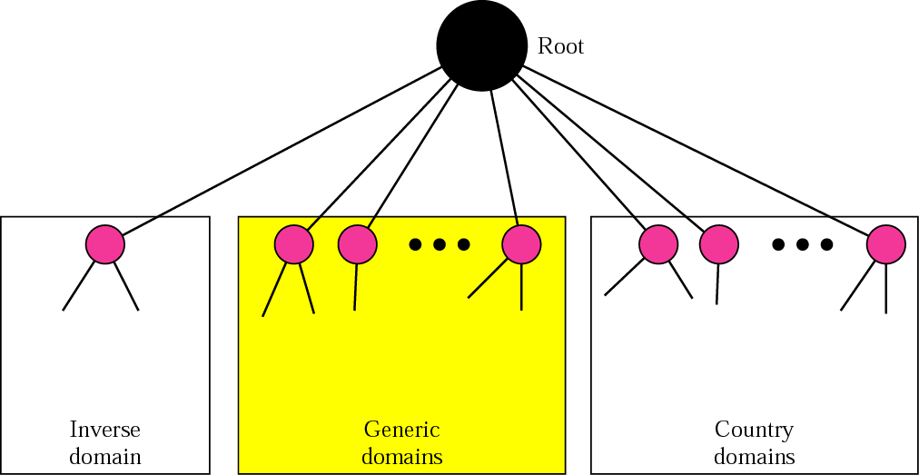
Figure 3.7 DNS used in the Internet
TCP/IP Protocol Suite

Slide 29
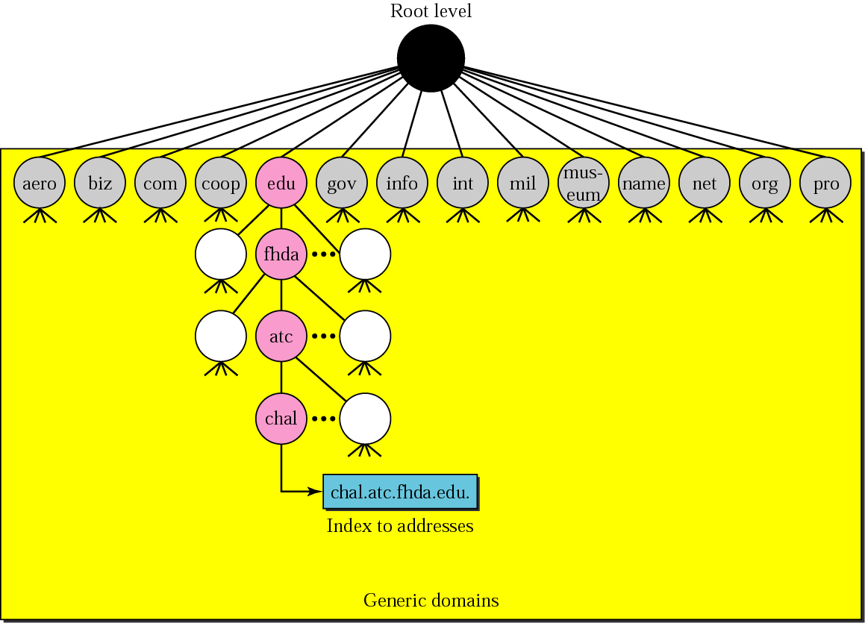
Figure 3.8 Generic domains
TCP/IP Protocol Suite

Slide 30
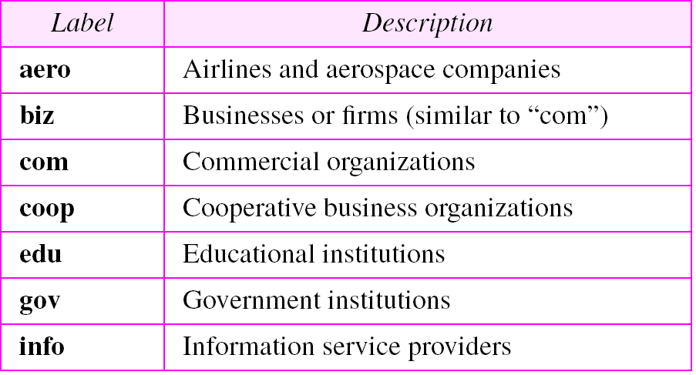
Table 3.1 Generic domain labels
TCP/IP Protocol Suite

Slide 31
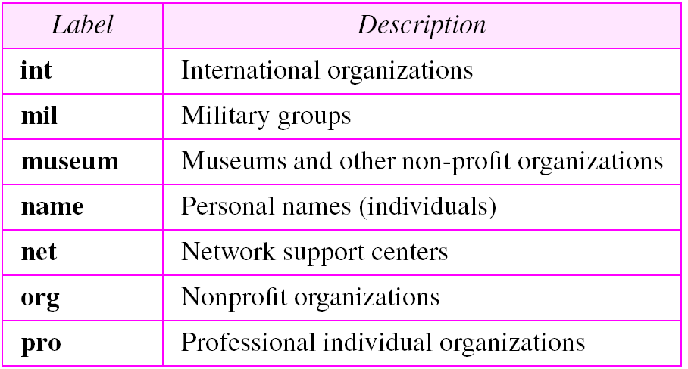
Table 3.1 Generic domain labels (Continued)
TCP/IP Protocol Suite

Slide 32
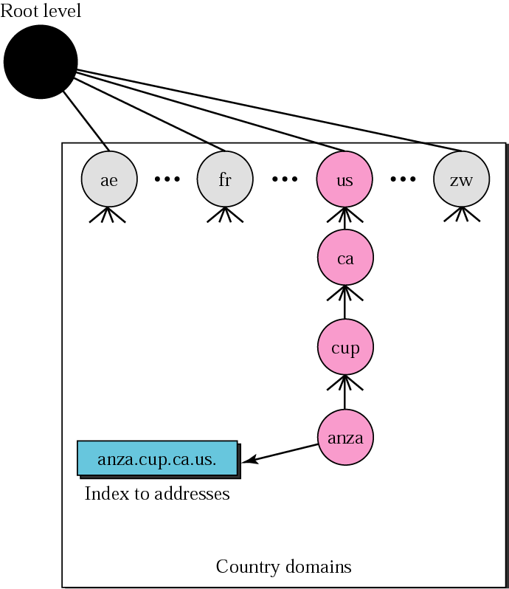
Figure 3.9 Country domains
TCP/IP Protocol Suite

Slide 33
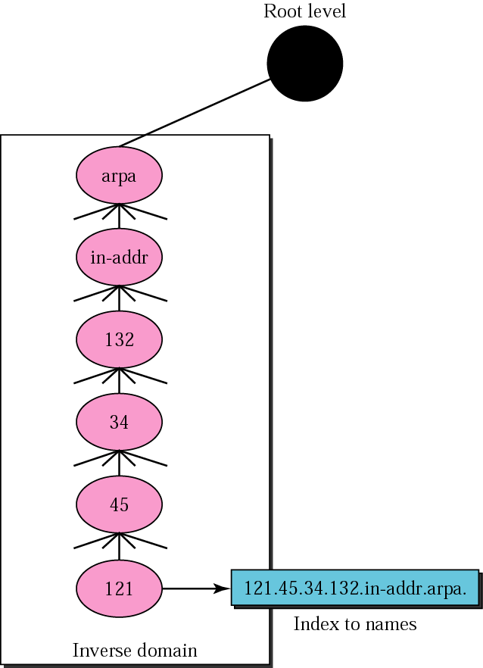
Figure 3.10 Inverse domain
TCP/IP Protocol Suite

Slide 34
3.5 RESOLUTION
Mapping a name to an address or an address to a name is called name-address resolution.
The topics discussed in this section include:
Resolver
Mapping Names to Addresses
Mapping Addresses to Names
Recursive Resolution
Iterative Resolution
Caching
TCP/IP Protocol Suite

Slide 35
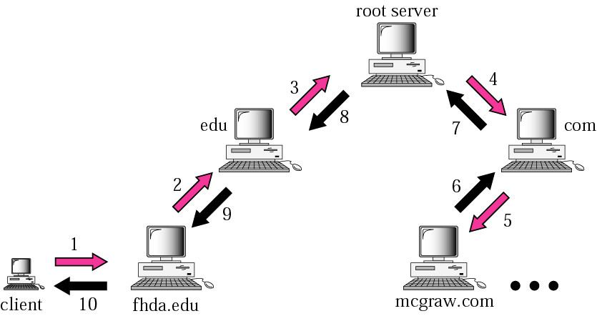
Figure 3.11 Recursive resolution
TCP/IP Protocol Suite

Slide 36
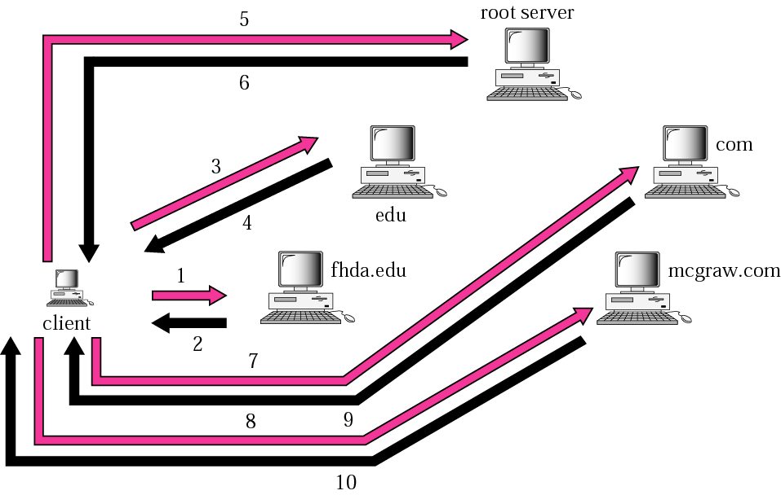
Figure 3.12 Iterative resolution
TCP/IP Protocol Suite

Slide 37
3.6 DNS MESSAGES
The DNS query message consists of a header and question records; the DNS response message consists of a header, question records, answer records, authoritative records, and additional records.
The topics discussed in this section include:
Header
TCP/IP Protocol Suite

Slide 38
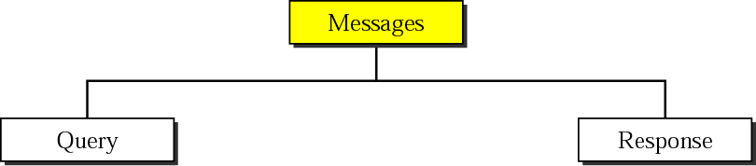
Figure 3.13 DNS messages
TCP/IP Protocol Suite

Slide 39
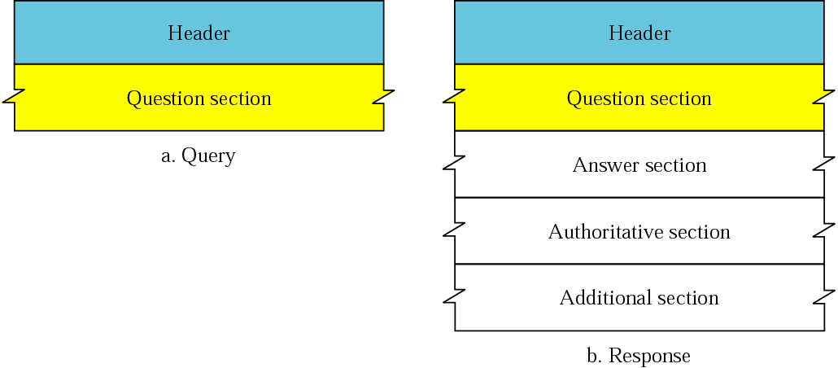
Figure 3.14 Query and response messages
TCP/IP Protocol Suite

Slide 40
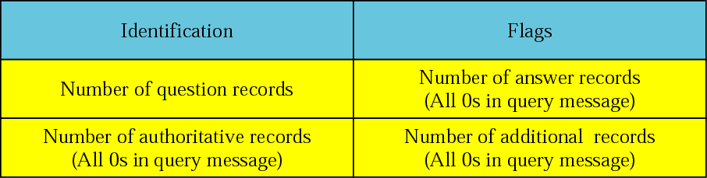
Figure 3.15 Header format
TCP/IP Protocol Suite

Slide 41
Figure 3.16 Flags field
TCP/IP Protocol Suite

Slide 42
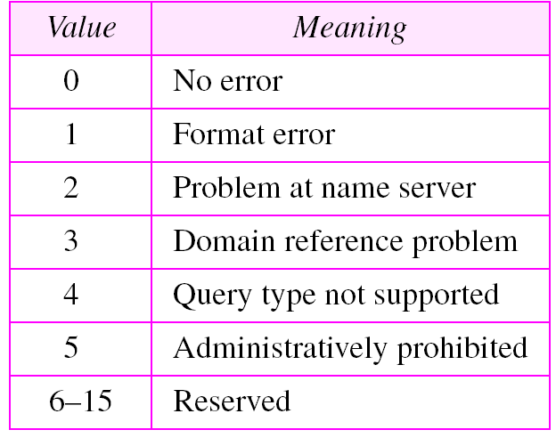
Table 3.2 Values of rCode
TCP/IP Protocol Suite

Slide 43
3.7 TYPES OF RECORDS
Two types of records are used in DNS. The question records are used in the question section of the query and response messages. The resource records are used in the answer, authoritative, and additional information sections of the response message.
The topics discussed in this section include:
Question Record
Resource Record
TCP/IP Protocol Suite

Slide 44
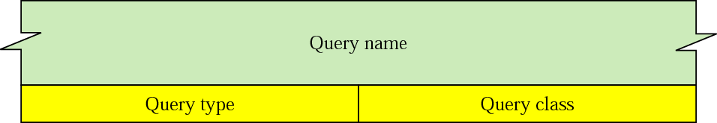
Figure 3.17 Question record format
TCP/IP Protocol Suite

Slide 45
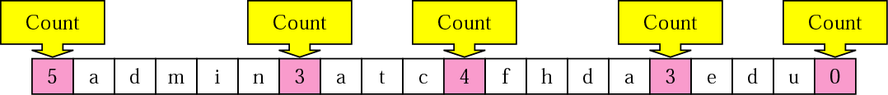
Figure 3.18 Query name format
TCP/IP Protocol Suite

Slide 46
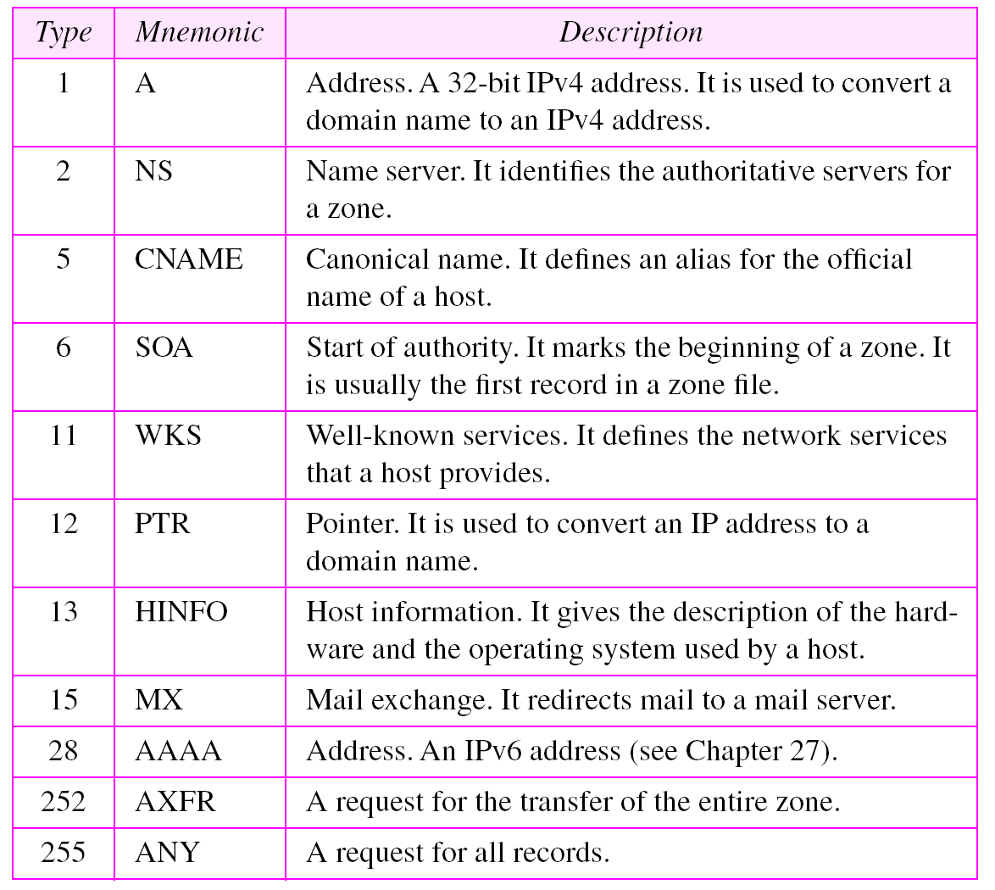
Table 3.3 Types
TCP/IP Protocol Suite

Slide 47
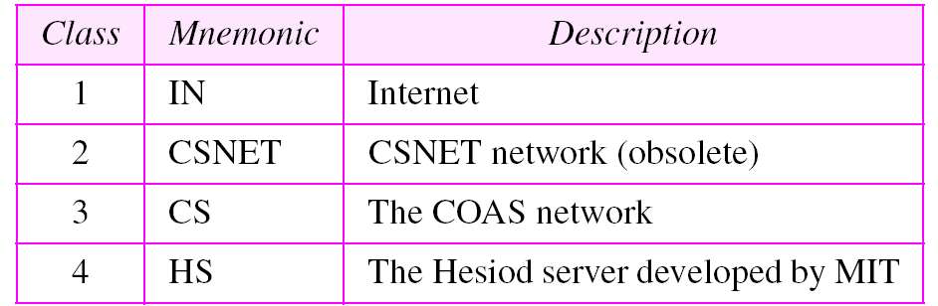
Table 3.4 Classes
TCP/IP Protocol Suite

Slide 48
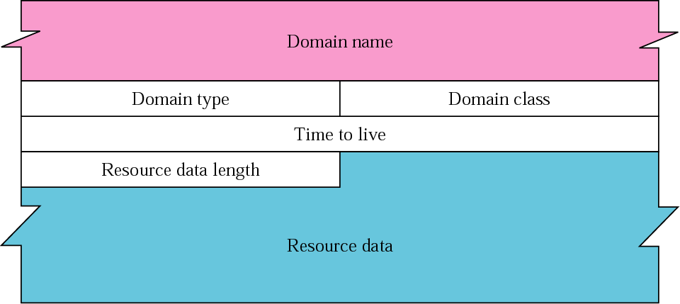
Figure 3.19 Resource record format
TCP/IP Protocol Suite

Slide 49
3.8 COMPRESSION
DNS requires that a domain name be replaced by an offset pointer if it is repeated. DNS defines a 2-byte offset pointer that points to a previous occurrence of the domain name or part of it.
TCP/IP Protocol Suite

Slide 50
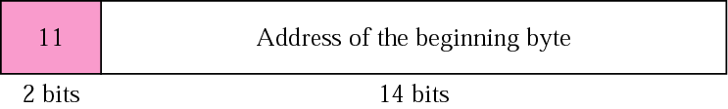
Figure 3.20 Format of an offset pointer
TCP/IP Protocol Suite

Slide 51
Example 1
A resolver sends a query message to a local server to find the IP address for the host “chal.fhda.edu.”. We discuss the query and response messages separately.
Figure 3.21 shows the query message sent by the resolver. The first 2 bytes show the identifier (1333). It is used as a sequence number and relates a response to a query. Because a resolver may even send many queries to the same server, the identifier helps to sort responses that arrive out of order. The next bytes contain the flags with the value of 0x0100 in hexadecimal. In binary it is 0000000100000000, but it is more meaningful to divide it into the fields as shown below:
QR OpCode AA TC RD RA Reserved rCode
0 0000 0 0 1 0 000 0000
TCP/IP Protocol Suite

Slide 52
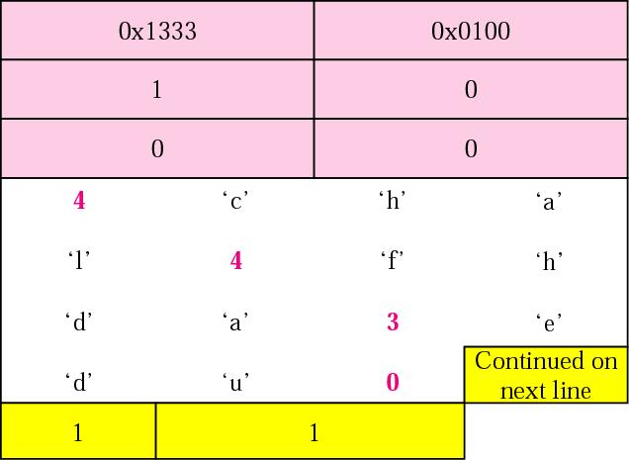
Figure 3.21 Example 1: Query message
TCP/IP Protocol Suite

Slide 53
Example 1 (Continued)
The QR bit defines the message as a query. The OpCode is 0000, which defines a standard query. The recursion desired (RD) bit is set. (Refer back to Figure 3.16 for the flags field descriptions.) The message contains only one question record. The domain name is 4chal4fhda3edu0. The next 2 bytes define the query type as an IP address; the last 2 bytes define the class as the Internet.
Figure 3.22 shows the response of the server. The response is similar to the query except that the flags are different and the number of answer records is one. The flags value is 0x8180 in hexadecimal. In binary it is 1000000110000000, but again we divide it into fields as shown below:
QR OpCode AA TC RD RA Reserved rCode
1 0000 0 0 1 1 000 0000
TCP/IP Protocol Suite

Slide 54
Example 1 (Continued)
The QR bit defines the message as a response. The OpCode is 0000, which defines a standard response. The recursion available (RA) and RD bits are set. The message contains one question record and one answer record. The question record is repeated from the query message. The answer record has a value of 0xC00C (split in two lines), which points to the question record instead of repeating the domain name. The next field defines the domain type (address). The field after that defines the class (Internet). The field with the value 12,000 is the TTL (12,000 s). The next field is the length of the resource data, which is an IP address (153.18.8.105).
TCP/IP Protocol Suite

Slide 55
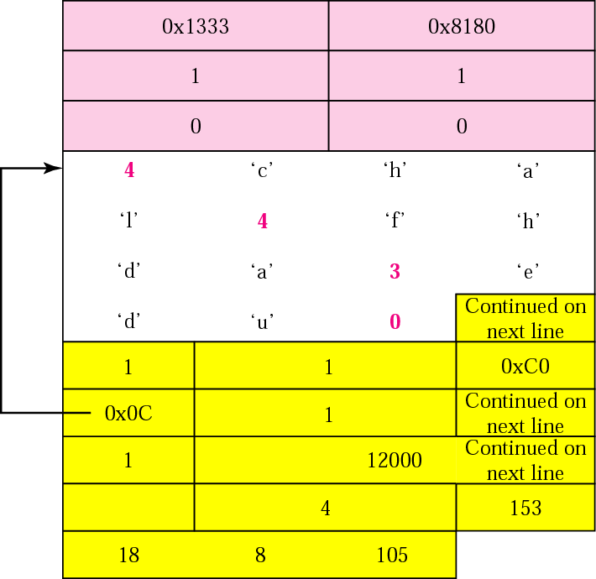
Figure 3.22 Example 1: Response message
TCP/IP Protocol Suite

Slide 56
Example 2
An FTP server has received a packet from an FTP client with IP address 153.3.7.9. The FTP server wants to verify that the FTP client is an authorized client. The FTP server can consult a file containing the list of authorized clients. However, the file consists only of domain names. The FTP server has only the IP address of the requesting client, which was the source IP address in the received IP datagram. The FTP server asks the resolver (DNS client) to send an inverse query to a DNS server to ask for the name of the FTP client. We discuss the query and response messages separately.
TCP/IP Protocol Suite

Slide 57
Example 2 (Continued)
Figure 3.23 shows the query message sent from the resolver to the server. The first 2 bytes show the identifier (0x1200). The flags value is 0x0900 in hexadecimal. In binary it is 0000100100000000, and we divide it into fields
as shown below:
QR OpCode AA TC RD RA Reserved rCode
0 0001 0 0 1 0 000 0000
The OpCode is 0001, which defines an inverse query. The message contains only one question record. The domain name is 19171231537in-addr4arpa. The next 2 bytes define the query type as PTR, and the last 2 bytes define the class as the Internet.
TCP/IP Protocol Suite

Slide 58
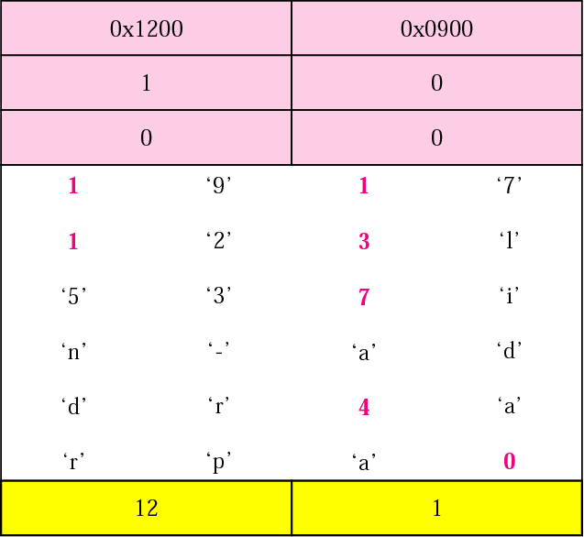
Figure 3.23 Example 2: Inverse query message
TCP/IP Protocol Suite

Slide 59
Example 2 (Continued)
Figure 3.24 shows the response. The flags value is 0x8D80 in hexadecimal. In binary it is 1000110110000000, and we divide it into fields as shown below:
QR OpCode AA TC RD RA Reserved rCode
1 0001 1 0 1 1 000 0000
TCP/IP Protocol Suite

Slide 60
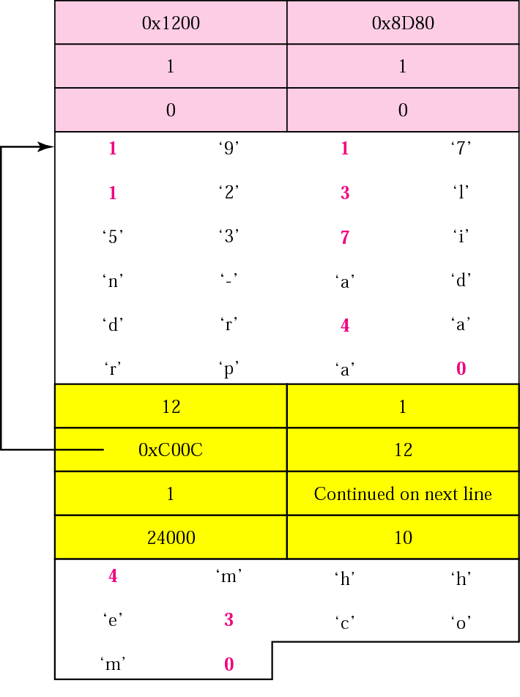
Figure 3.24 Example 2: Inverse response message
TCP/IP Protocol Suite

Slide 61
Example 3
In UNIX and Windows, the nslookup utility can be used to retrieve address/name mapping. The following shows how we can retrieve an address when the domain name is given.
$ nslookup fhda.edu
Name: fhda.edu
Address: 153.18.8.1
The nslookup utility can also be used to retrieve the domain name when the address is given as shown below:
$ nslookup 153.18.8.1
1.8.18.153.in-addr.arpa name = tiptoe.fhda.edu.
TCP/IP Protocol Suite

Slide 62
3.9 DDNS
The Dynamic Domain Name System (DDNS) updates the DNS master file dynamically.
TCP/IP Protocol Suite

Slide 63
3.10 ENCAPSULATION
DNS uses UDP as the transport protocol when the size of the response message is less than 512 bytes. If the size of the response message is more than 512 bytes, a TCP connection is used.
TCP/IP Protocol Suite

Slide 64
Note:
DNS can use the services of UDP or TCP using the well-known port 53.
TCP/IP Protocol Suite

